Slide 1

CrediTech
Your First Step to A Better Financial Future
Project link : https://github.com/iamdas3/ME-781-project

Slide 2

A startup started by a group of 5 members working in the credit industry for its betterment using a proper data-driven approach by our highly skilled and trained ML Engineers.
Our Target is Empowerment of the financial sector with less risk and more profit
Our Goals for the years ahead: To partner up with Credit Bureaus and Banks and help individuals throughout the world for achieving their credit goals

Slide 3
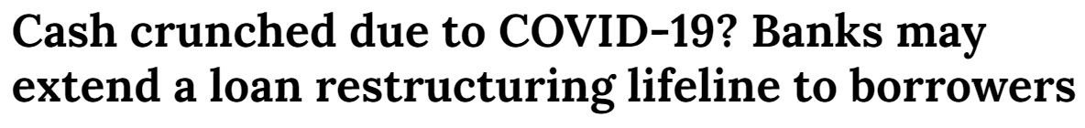
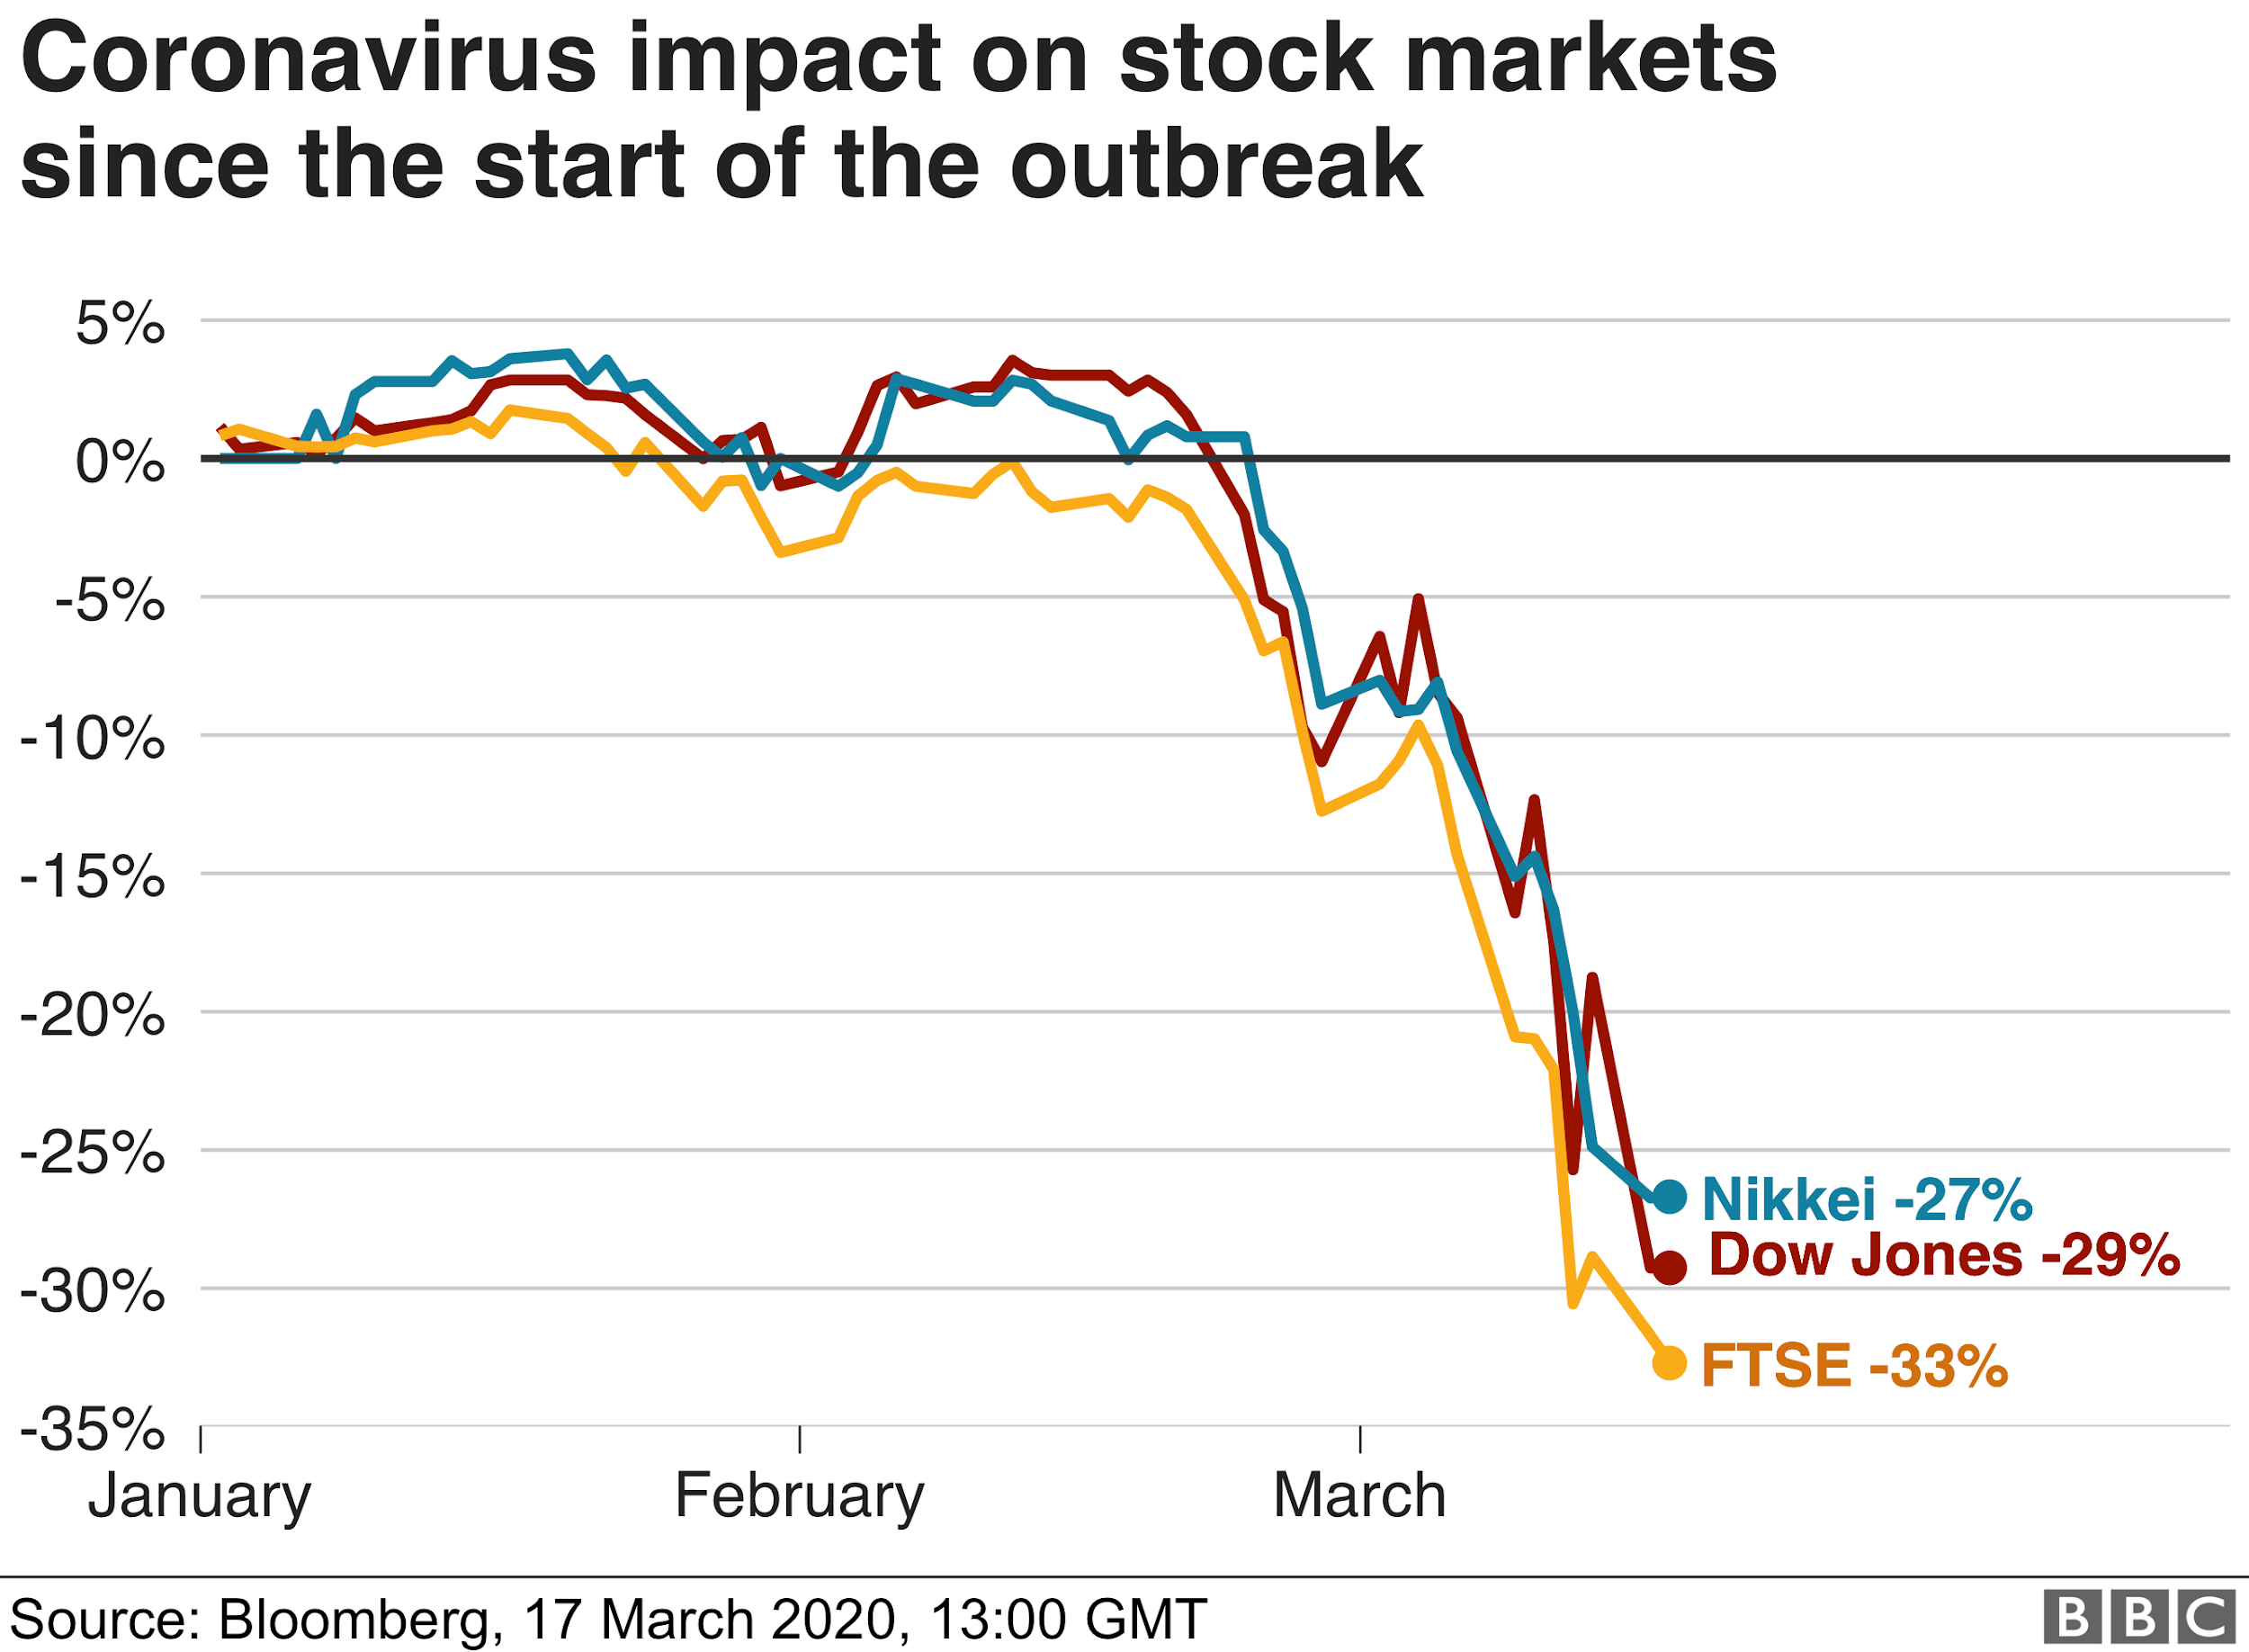
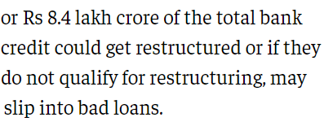
The problem
Bank Credit card defaults rates have always been a major problem for banks and other lending financial institutions.
Given the current scenario where the majority of the earning group is hit by a pandemic hence observe a job loss or pay cut, therefore Credit defaults rates are likely to increase

Slide 4
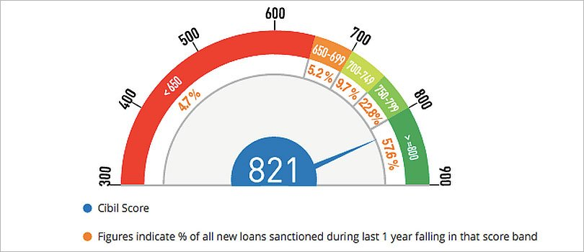
Continued
The already established scores like CIBIL might not be useful in the current situation due to the above given problems
Hence, we need to consider many other factors and find out what exactly affects the credit capacity and what steps can be taken to improve it.

Slide 5

Our Objective:
To provide a bias free factor for determining the creditworthiness of an individual

Slide 6

The solution
Using Machine Learning models using the financial and general information of an individual.
Finding the relevant factors involved in the process and take steps towards improvement using the obtained knowledge

Slide 7
How it works
Step 1
Step 2
Step 3
Step 4
Collection and Preprocessing of data and Relevant Feature selection
Model Training and accuracy comparison for Model selection
Optimizing hyperparameters for improving accuracy
Studying obtained information and setting goals for the future.

Slide 8
Extensive Details
We have performed a through exploratory data analysis on the dataset, The dataset contains general information and a few months of bills, payments and payment status for the same. Visualized the default rate variation with the features and provided a correlation matrix.
Logistic Regression is used as a benchmark and several other models have been implemented for comparison including Naive Bayes, K-NNs, Decision Trees, Random Forest Models.
Performance measures like Accuracy, Precision, Recall and F1-score are Compared for every model and they are further improved using Hyperparameter tuning, Gradient Boost and Adaboost

Slide 9
Our Expert ML Engineers
We provide simple and innovative solutions
We are focused to achieve the goal
What Differentiate us from others

Slide 10

Thank you for your attention
For further questions/assistance:
Email info@credi-tech.com
Contact +91 216-729-1337

